Slide 1

Azure webinar series
Get started migrating ASP.NET and WCF apps to Azure App Service
Notes:
Replace cover image: go to Format Background > Picture or texture file
Adjust gradient: go to View > Slide Master > Adjust shape fill options

Slide 2
Welcome

Slide 3

Meet our speakers
Paul Yuknewicz
@PaulYuki99
Notes:
Speaker image: Insert/Paste image > Picture Format > Crop > Aspect Ratio 1:1 > Crop > Crop to shape (circle) > Resize to template

Slide 4
Agenda
Migration goals
Strategies and targets
Demos and best practices
..Migrating to App Service
..Migrating to containers

Slide 5
Value to Optimize and Modernize
Agility
Time to market
Total cost of ownership
IT simplification
Continuous delivery
Containers
Scalability and HA
Insights and Analytics
Infrastructure Cost
Ongoing Maintenance
Standardization
Simplification
Notes:
Slide 7

Slide 6



I don’t have the luxury of creating a new app from scratch. What can I do?
Do I really need to learn new languages and new tooling to use the cloud?
Can I reuse my existing codebase? I would love to build from there.

Slide 7
Cloud maturity spectrum
Lift and Shift
Modernize DevOps
Modernize for Cloud
Zero Code Changes
Minimal Code Changes
New Code
Migrate
Modernize
Born in the Cloud

Slide 8
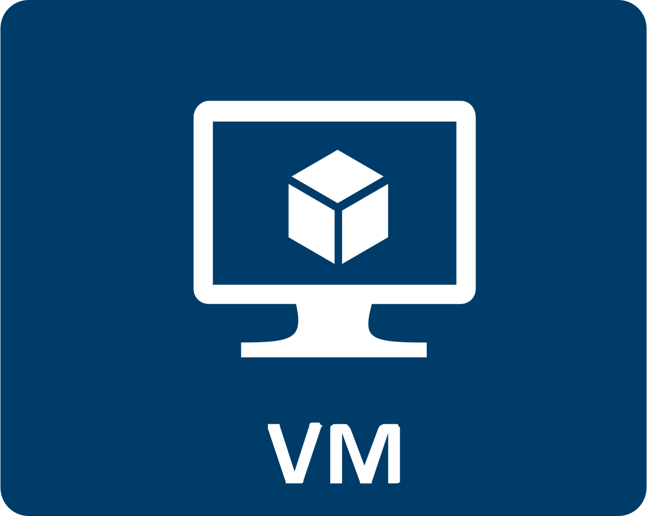
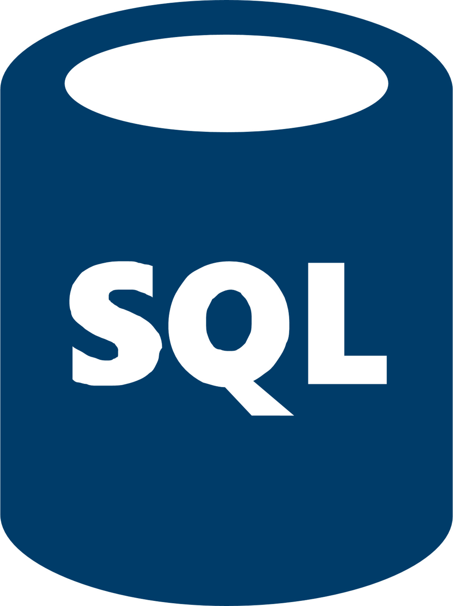




Cloud maturity spectrum
Lift and Shift
Modernize DevOps
Modernize for Cloud
(Containers, DevOps)
(PaaS, Serverless, Microservices
Azure VMs (IaaS)
Azure SQL Database Managed Instance
Docker Containers
AKS
Azure SQL Database Managed Instance
CI/CD
App Service
SQL Database
Functions
CI/CD
Zero Code Changes
Minimal Code Changes
New Code

Slide 9
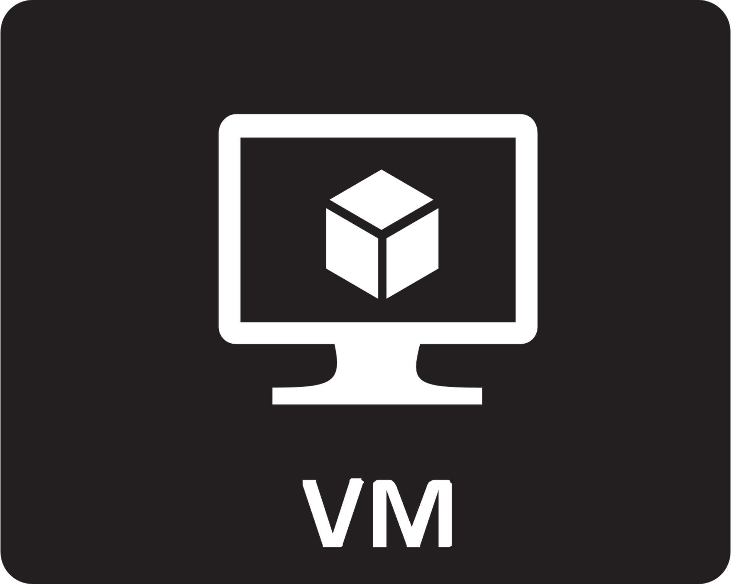



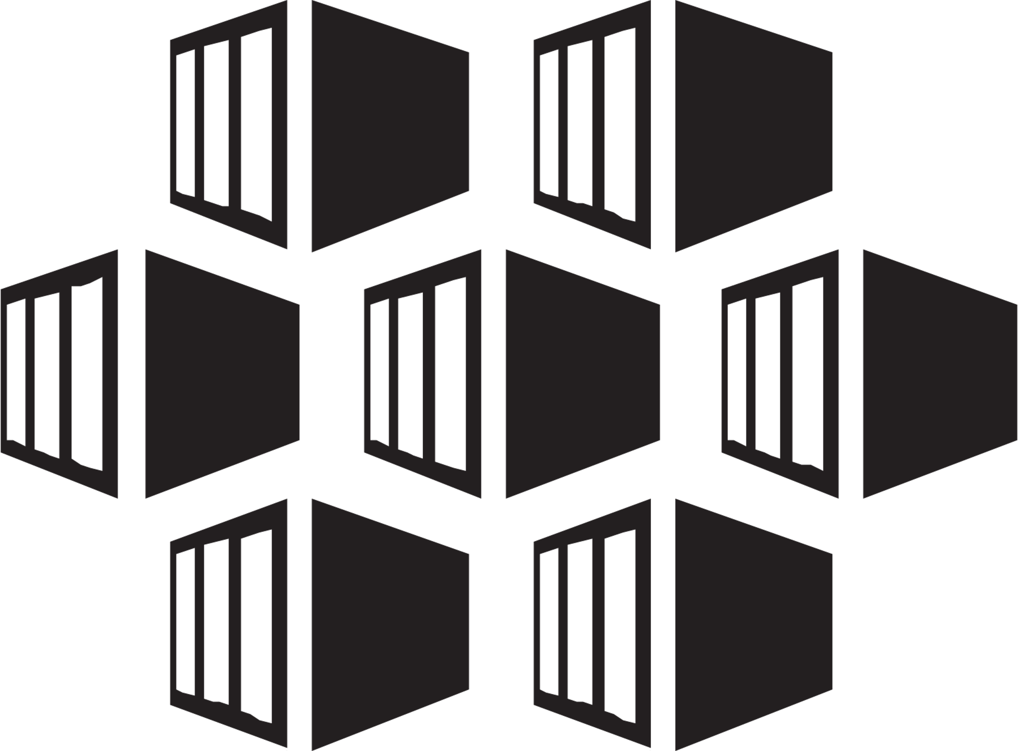




Cloud Maturity Spectrum
Existing ASP.NET website with SQL Server database | Lift and Shift | Modernize DevOps (use containers, DevOps) | Modernize for Cloud (use PaaS, serverless, microservices, DevOps) | Enhance (use cloud native for new work)
 | Azure VMs (IaaS) Azure SQL Database Managed Instance | Visual Studio Windows/Linux Containers + Docker, Azure SQL Database Managed Instance | App Service SQL / Managed Instance Functions | Microservices CosmosDb CI/CD
Zero Code Changes
Minimal Code Changes
New Code
Migrate
Modernize
Born in the cloud apps

Slide 10
Modernize App – App service
Benefits
Eligibility checklist
Rework needed
Web Apps, API Apps
Fully managed: OS patching, High Availability, Scaling
Diagnostics & monitoring integration
Deployment slots
First class Visual Studio integration
Hybrid networking options
Built-in Azure monitoring
Stateless Web app or API
Single service apps
No system or admin components
Filesystem to Azure storage
Registry to environment vars
Sign in, auth, AD
IIS configurations
Multiple IIS services

Slide 11

Compatibility checklist – Can my .NET app move?
Checklist
Ensure port bindings 80 (Http) or 443 (Https)
Anonymous & forms authentication supported. Windows auth with Azure Active Directory or ADFS & VPN
No GAC (Global Assembly Cache) usage
Single Application Pool per site
IIS7+ Schema Compliance
No COM/COM+ components
No reference to physical directories. Use blob storage to mimic file access.
Verify access to on-premises resources as they may need to be migrated/changed
SQL Server, Oracle, MySQL databases
ISAPI Filters DLL(s) need to be deployed locally and registered via web.config
Follow this checklist to determine if the app needs some refactoring

Slide 12
Modernize App – Azure SQL
Benefits
Eligibility checklist
Fully managed: OS patching, High Availability, Scaling
Geo replication
First class tooling
Compatibility with SQL Server
SQL Migration service
Built-in Azure monitoring
No SQL CLR
*No changes to model or master database
* Use SQL Managed instance in these cases

Slide 13
SmartHotel360 application – Before
My Datacenter
Physical Infrastructure
VM
VM
VM
VM
WCF
WCF
Web Forms
Web Forms
DB
DB
IIS
IIS
SQL
SQL

Slide 14
SmartHotel360 application – Incremental (Hybrid)
My Datacenter
Azure App Service Plan (instance 1)
VM
VM
Web Forms
WCF
VPN /
Hybrid Connection
DB
SQL
Azure
On-premises

Slide 15
Demo
Prepare migrate front-end

Slide 16
SmartHotel360 application – Ideal
Azure
Virtual Infrastructure
Azure App Service Plan (instance 1)
Azure App Service Plan (instance 2)
WCF
WCF
Web Forms
Web Forms
Azure SQL DB*
Azure SQL Server
*SQL Managed Instance option for 100% compat

Slide 17
Demo
Migrate back-end | Add monitoring

Slide 18
Modernize DevOps – Docker containers
Benefits
Eligibility checklist
Rework needed
Agility: rapid deployment and updates
Multi service/layer distributed apps
Independent scaling
Vendor managed/patched images
Bring your own dependencies
First class tooling
Flexible networking options
Stateless workloads (move now)
Visual Studio 2017 tools chain
AD, MSMQ, MSDTC
Filesystem migration to volume mounts

Slide 19
Windows Containers hosting in Azure
Fully supported
Preview services
Service Fabric Cluster
Service Fabric Mesh
App Service Containers for Windows

Slide 20
Demo
Containerize | Orchestrate
Notes:
1) Web App
- create a simple web app
-flash over to our RG
-show the start web app
Speak to SSL
Scale out with more instances
Slots
2) SQL
Just like SQL server but managed by azure, built from the same source code..
Here’s a server and a db
Connect .. Using Visual Studio
Note how firewall blocks external by default, but our tools offer to add your dev machine IP
Log in
Expand tables – “look, we have the tools you need to view and edit”

Slide 21
Lift and Shift App – Azure VMs
Benefits
Eligibility Checklist
Easiest migration, no rework needed
Elastic scale of infrastructure
Monitoring is easy to enable
Azure networking, security, and VNETs
All workloads
Down-sides
Rework needed
Patching is still manual
Operations is still manual
Network configuration

Slide 22
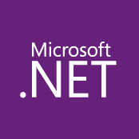

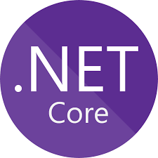

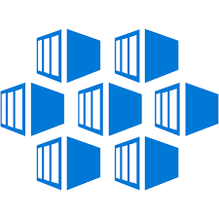
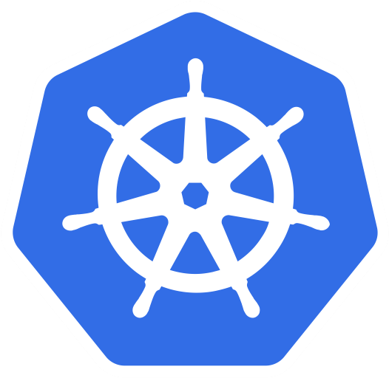





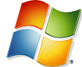


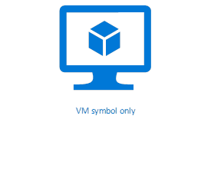






Maturity model for .NET application modernization
Existing apps
.NET web apps (on-premises)
Cloud
Infrastructure-Ready
Cloud-Optimized
PaaS
Cloud-Native
PaaS for microservices and serverless
Monolithic / N-Tier
architectures
Monolithic / N-Tier
architectures
Monolithic / N-Tier
architectures
Microservices and serverless architectures
Relational Database
IaaS
(Infrastructure as a Service)
Managed services
VMs
PaaS for containerized microservices
+ Serverless computing
+ Managed services
And Windows Containers
On-premises
Azure
Azure
Azure
Base Cloud Environment and cross-cutting concerns: Network, Hybrid-cloud, Identity/Auth, Cost control and Operations model
Migrate / Rehost
Modernize
Minimal code changes
Architected for the cloud, new code
Notes:
What’s next?
Modernize applications with .NET Core
Many applications will benefit from modern architecture built on .NET Core – a much faster, modular, cross-platform, open source .NET. Websites can be modernized with ASP.NET Core to bring in better security, compliance, and much better performance than ASP.NET on .NET Framework. .NET Core also provides code patterns for building resilient, high-performance microservices on Linux and Windows.

Slide 23
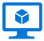







Azure Services Recommendations for .NET Apps
Azure Services
 | Azure Virtual Machines (VMs) | Azure App Service | Azure Kubernetes Service (AKS) | Azure Functions | Azure Batch | Azure Container Instances (ACI)
Web apps (Monolithic architecture)
N-Tier apps (Coarse-grain services)
Cloud-Native (Microservices architecture)
Batch / Jobs (Background tasks)
Recommended
Application
Architecture
Recommended
Recommended
Recommended
Azure
event-driven
Recommended
Application’s
background tasks
Recommended
Large Batch scale
Recommended
Recommended
Possible
Notes:
As you look to modernize with .NET Core and microservice / serverless / event driven architectures, there are more options and recommendations. Here they are.
Service Sweet spots
Azure Container Instances
Run individual containers with no VM management
Azure App Service Web Apps
Deploy scalable web apps and services (with or without using containers)
Azure Kubernetes Service (AKS)
Use leading OSS orchestrator and associated CNCF tools to deploy and manage containers
Azure Batch
Schedule large scale batch processes deployed in containers

Slide 24
Summary
App Service and SQL most valuable for eligible apps
Containerize to improve agility and dependencies
Modernize your monitoring and CI/CD pipeline

Slide 25
Additional resources
https://aka.ms/migratetothecloud
https://github.com/paulyuk/modernizewithappservice
https://github.com/MikkelHegn/SmartHotel360-internal-booking-apps

Slide 26
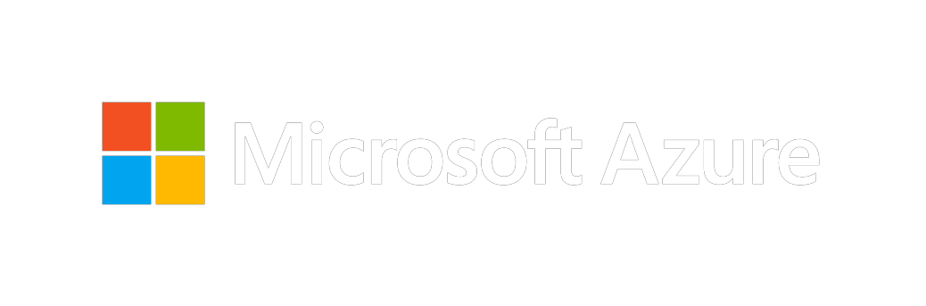
Thank you for joining us.
© 2018 Microsoft Corporation. All rights reserved. Microsoft, Windows, Windows Vista and other product names are or may be registered trademarks and/or trademarks in the U.S. and/or other countries.
The information herein is for informational purposes only and represents the current view of Microsoft Corporation as of the date of this presentation. Because Microsoft must respond to changing market conditions, it should not be interpreted to be a commitment on the part of Microsoft, and Microsoft cannot guarantee the accuracy of any information provided after the date of this presentation. MICROSOFT MAKES NO WARRANTIES, EXPRESS, IMPLIED OR STATUTORY, AS TO THE INFORMATION IN THIS PRESENTATION.

Slide 27

Maintaining aging technology also creates barriers
Yesterday
Today
Application silos, built for web
Multi-channel applications, web, mobile, agents, IoT
Static apps, serve up stored data
Data-driven apps, personalize in real-time
Servers and infrastructure to manage
Remove maintenance efforts, redirect to innovation
Upfront capacity planning, fixed scale
Elastic, unlimited scale
Optimized for decade old security threats
Intelligent protection detects threats, notifies
Built for hardware + software refresh cycles
Ongoing + seamless innovation built-in
Notes:
As the business world moves into the digital space to meet the next generation of customers, employees and partners, create new efficiencies, and compete globally, organizations can’t view applications the same way as before – they must take them to the next level.
Are your applications ready for this new tomorrow?

Slide 28

…and impacts an organization’s ability to reduce costs
High costs related to incidents
High costs spent on IT tasks
High costs spent on processes
$360B
Can be saved over the next 15 years with a global annual investment of just $6M in infrastructure preparedness¹
80%
Of IT administration time spent on patching, network setup, and firewall configuration.2
1.1B
Hours annually can be saved with AI and automation³
¹UN Office for Disaster Risk Reduction, 2015
2The Total Economic Impact™ Of Microsoft Azure Platform-As-A Service, Forrester Consulting, June 2016
³“A Future the Works: Automation, Employment and Productivity” McKinsey Global Institute, 2017
Notes:
We are now in the 4th Industrial Revolution. In the 1780s we saw the advent of steam, water, and mechanical production. In the 1870s we saw the division of labor, electricity, and mass production, in the 1970s we saw electronics, IT, and automated production emerge, and now in this Industrial Revolution 4.0 we are blurring the physical and the digital divide.
All over the world, people have access to technology that only a few years ago seemed impossible. Farmers in Myanmar are using cheap mobile phones to learn and share farming tips on Facebook. Villagers in remote areas of Uganda are using personal solar units for electricity, paying the monthly lease through their smartphone—phones that are enabled because of their solar units. There are now more mobile devices than there are people on this planet—virtually everyone, everywhere has mobile access to the internet, social media and the masses of data behind them. As a result, the expectation is not only for mobile access to government services but also for a seamless, customer-friendly user experience that is seen in apps and on popular social media sites. In this age of rapid digital transformation, new technology and public expectation are defining a new digital standard. To keep up, governments of today must:
Look for ways to drive citizen engagement. Citizen engagement is a crucial component to building trust and optimizing services to fit the unique needs of a unique population – in fact, a recent report shows that citizen’s likelihood to trust government institutions increases by 58% if they provide access to a great digital experience. An important component of this is delivering anytime, anywhere access to services.
Advance beyond a reactive approach to deliver proactive service. By implementing IoT-empowered predictive maintenance to detect trouble before it arises, repairs to infrastructure systems can be completed proactively saving time, money and promoting citizen trust. Predictive maintenance solutions implemented today have been shown to reduce equipment downtime by an average of 50% - with the advent of advanced machine learning, efficiency will only continue to grow.
Continue to streamline processes. In the US alone, an estimate of 1.1B federal hours can be saved annually through AI and automation. This frees up government employees to focus on improvement projects rather than routine, rhythm of the business activities.
Build citizen trust and avoid PR nightmares through proactive measures that minimize costly incidents. The UN Office for Disaster Risk Reduction reported that $360B can be saved over the next 15 years if governments were to make a total global annual investment of just $6M. At present, government spending on preparedness and resilience remains low—governments spend on average less than 0.5% of development aid on disaster preparation. From frustrating bridge closures due to unexpected repairs, to dangerous water quality issues, an ounce of preventative public work is worth a pound of post-incident cleanup.
And finally, nowhere is the concept of “do more with less” felt more than in government. Costs are being pushed up and continue to rise, largely due to a growing population who are living and working longer. The natural consequence is increasing demand for a higher standard and wider variety of public services, further driven by increased consumer experience expectations. At the same time government balance sheets are under pressure to stay flat or decline, controlling the total costs of government, reducing borrowing deficits, and avoiding highly unpopular tax raises. To help manage expenses, governments are looking to maximize tax collection, prevent fraud and minimize waste.
T: However, meeting these demands is no simple task.
Sources:
https://learn.foresee.com/the-foresee-e-government-satisfaction-index-q1-2017
https://spotfire.tibco.com/resources/datasheet/predictive-maintenance-how-data-can-increase-production
https://www.mckinsey.com/mgi/overview/2017-in-review/automation-and-the-future-of-work/a-future-that-works-automation-employment-and-productivity
https://www.reuters.com/article/us-global-environment/put-a-price-on-the-costs-of-disasters-says-u-n-risk-chief-idUSKBN17S2RJ
https://www.mckinsey.com/business-functions/digital-mckinsey/our-insights/the-internet-of-things-the-value-of-digitizing-the-physical-world
Additional stats:
75% of reported incidents in a recent survey required field technicians to make a return visit. Source: “Connected Manufacturing Service Report,” Harris Poll, 2016
$930B in estimated global savings can be achieved by 2025 through the implementation of IoT in cities. Source: McKinsey Global Institute, June 2015
$393M is the total cost of rebuilding collapsed I-35W bridge in Minnesota, US that collapsed in August 2007, killing 13 and injuring 145 people

Slide 29
A modernization strategy drives innovation + growth
80%
Websites
Data analysis
Administration
running in minutes
Remove patching, network setup, firewall configuration
Enable application innovation
Remove the need to wait for servers²
Improve app delivery time by 50%¹
With cloud, we collect data we couldn’t before
Make personal connections that standout in sea of information
-- Forrester TEI of Azure¹
-- Anheuser-Busch InBev
Organizations that harness data, the cloud, and AI outperform their peers³
2x
$100M
~
operating margin
additional
operating income
¹The Total Economic Impact™ Of Microsoft Azure Platform-As-A Service, Forrester Consulting, June 2016
³Source: Keystone Strategy interviews Oct 2015 - Mar 2016
-- Anheuser-Busch InBev
Notes:
Removed 80% of administrative tasks, allowing the organization to focus on application innovation, not administrative tasks. The organization used to spend significant time on server patching, networking setup, firewall configuration, and many other server-related tasks now included with Azure PaaS.”
Increased advanced data analysis. “By moving to Azure, we get away from managing core infrastructure and instead focus on making innovative services available to the company. “We’ve made a big change in the way we connect with our customers, By using sophisticated data analysis, we are able to make a personal connection that stands out in the vast sea of information that washes over us all every day.” InBev

Slide 30
Software and hardware refresh
Security threats
Urgent capacity needs
Compliance
Quickly integrate acquisitions
Application innovation
Migration & modernization triggers
Software end of support
Datacenter contracts expiry
Notes:
2 patterns:
Look for and listen deeply to your customers’ migration/modernization triggers. That will help you position appropriate urgency around migration.
Situations like end of support, DC lease expiry, acquisition integration signal time-bound deadlines.
App innovation might be tops down driven and needs to be dealt with strategically.

Slide 31
EOS presents opportunity to modernize your infrastructure & avoid business risk
2008 | R2
No security updates
Compliance &
regulatory concerns
Windows Server
Ends January 14, 2020
$
Additional cost for support + patches
Missed innovation opportunities
SQL Server
Ends July 9, 2019
Find lifecycle support deadlines at: support.microsoft.com/lifecycle

Slide 32

3 reasons to migrate/modernize 2008 server applications to Azure now
Modernize with
cloud innovation
Pay less with
Azure
Improve security
and compliance
Azure IaaS
Azure SQL Database Managed Instance
Azure App Service
Azure migration center
Scenario guides
Free extended security updates (ESUs)
Azure Hybrid Benefit
Infrastructure optimization
Example: Save $750K for 100 eos servers over 3 years (vs. on-prem)
Go ‘evergreen’: ESUs or SQL managed instance
More certifications than other providers
Built-in, multi-layered security controls
EOS Security datasheet
Notes:
You folks told us that there’s no urgency around EOS. To counter here are a few key messages to land with customers.
Note that we are solving for two things: 1) Do nothing – i.e., stay on-premises 2) Drive Azure preference vs. AWS.
Innovation. Embrace cloud innovation as you migrate to gain agility, performance, and global scale. Maximize your productivity with fully-managed Azure services, and focus your energies on driving the business forward.
[vs. AWS]
Azure SQL Database Managed Instance delivers unparalleled consistency, compatibility, and performance vs. AWS RDS. Migrate your SQL Server databases without changing your apps.
Azure SQL Datawarehouse delivers unmatched price-performance vs. AWS RedShift.
Windows Server and Azure deliver unique integrated hybrid experiences: Trigger migration to Azure. Backup to Azure. Turn on Disaster Recovery. All in a few clicks.
[vs. on-premises]
Migrate your mission-critical applications and workloads – Windows, SQL, Linux - to Azure IaaS, which delivers reliable infrastructure at global scale.
Migrate your ASP.NET websites to Azure App Service for a highly productive experience, where we manage the infrastructure so you can focus on your apps.
Pay less with Azure. Azure is the most cost-effective for Windows and SQL Server. AWS is 5x more expensive. Reduce TCO as you move to Azure using our unique offers & optimized infrastructure.
[vs. AWS] - AWS is 5x more expensive with Azure Hybrid Benefit and free extended security updates available only in Azure.
[vs. on-premises]
Realize substantive cost savings with free extended security updates, Azure Hybrid Benefit, and optimized infrastructure. Save up to $750K when you move one hundred 2008 servers to Azure.
Azure offers free tools before, during, and after migration: Azure Migrate, Azure Site Recovery, Azure DMS, and Azure Cost Management
Security and compliance. Migrate to Azure, which carries the most trust with enterprises. Minimize business risk by strengthening your security and compliance posture.
[vs. AWS and on-premises]
Help meet compliance requirements with the most comprehensive certifications of any cloud provider.
Never have to worry about another end of support cycle. Migrate your SQL Servers to Azure SQL Database Managed Instance, an ‘evergreen’ service that is kept patched and updated by Microsoft.
Move your Windows/SQL Servers to Azure Virtual Machines and you’re covered for three more years with extended security updates. Use this time to fully plan and execute your modernization efforts.
Counter sophisticated cyberthreats with built-in, multi-layered controls in Azure. Your workloads get continuous protection with rich threat intelligence from Azure Security Center.
Optimize for speed and control. Use Azure Blueprints to set up and govern your Azure environments and help ensure compliance during migration.

Slide 33
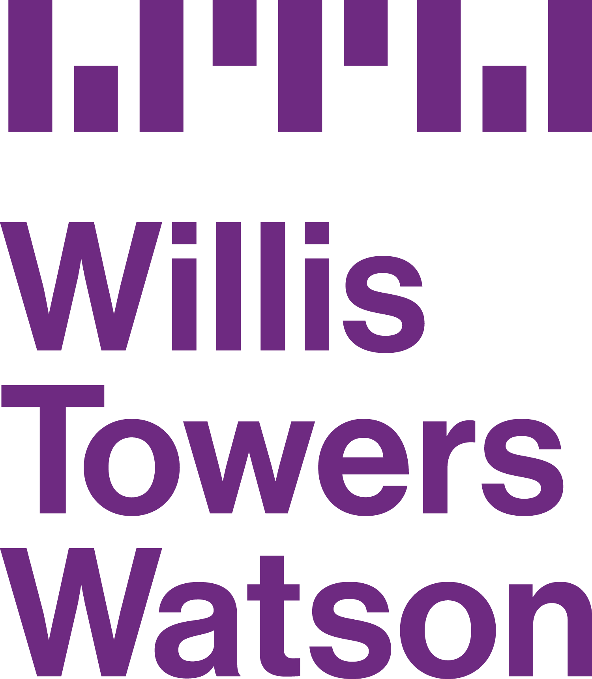


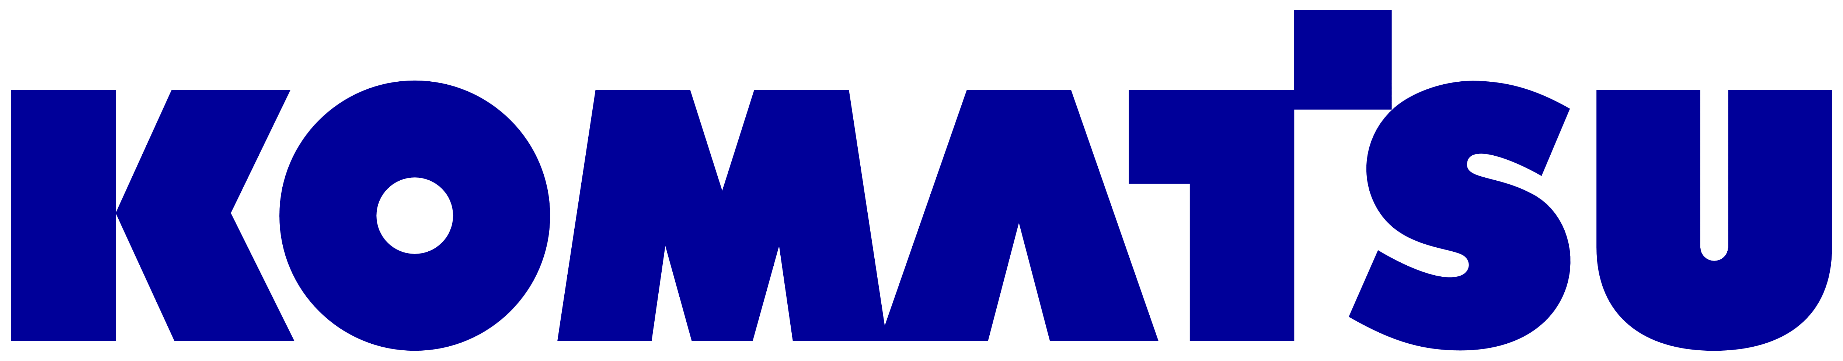

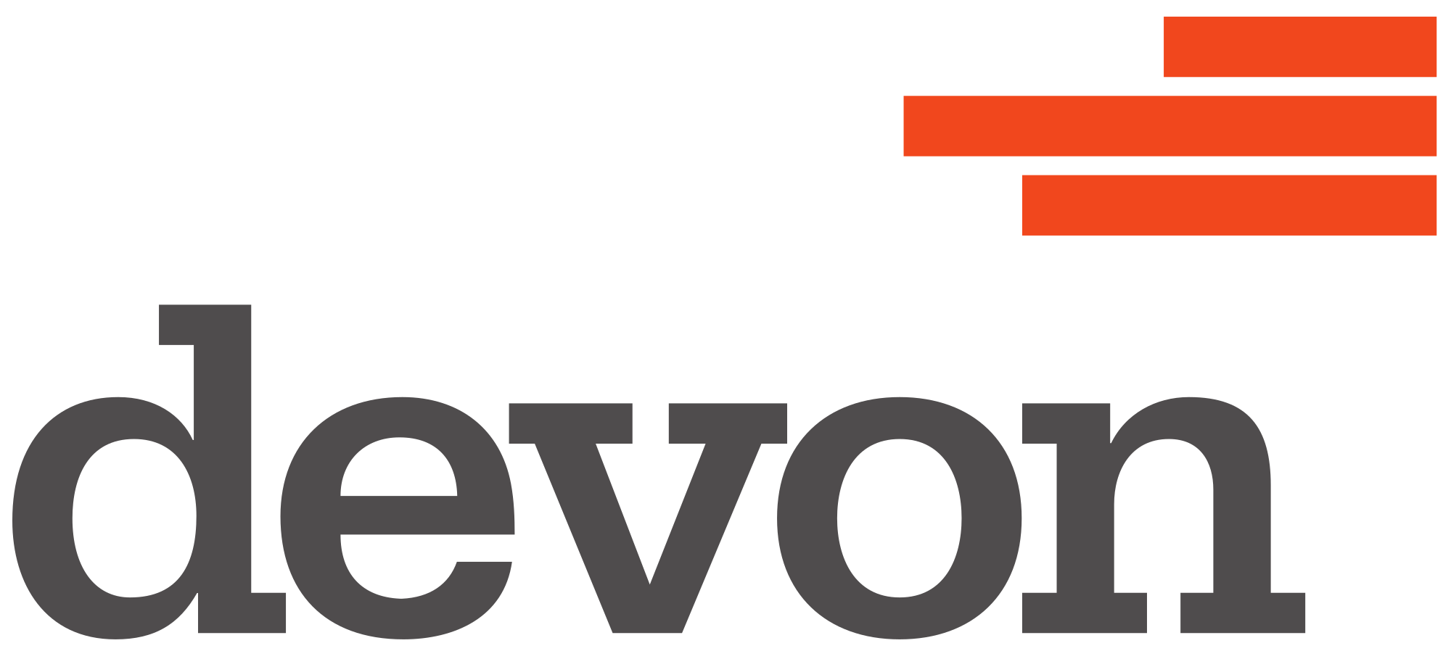
Customer momentum
"Azure Site Recovery has helped us migrate several hundred business critical workloads—including Linux, MySQL, Windows, SQL Server, in a weekend—more quickly, reliably, and securely than we could ever before."
“Azure Database Migration Service was a life saver…we successfully migrated over 100 databases to Azure using the service over two months without any downtime or loss of data.”
“We were able to migrate and modernize several critical Linux, Windows and Java applications to Azure while continuing to run on-premises operations, thanks to Azure hybrid capabilities.”
“We were able to deploy our TimeXtender solution into production on Azure SQL Database Managed Instance in a matter of weeks. We immediately realized a 49% cost savings…..”
“We used SQL Database Managed Instance, a way to migrate huge databases into Azure cloud without changing any code, and stay compliant with all the applications so we can make a one-to-one transfer. ”
“For our cloud journey, we were looking to engage in an emphatic relationship….and Microsoft was the only partner who was prepared to walk side by side with us. ” – Ben Williams, CIO, Devon Energy
Notes:
These are customers who have gone through the journey and are seeing real benefits in terms of hard $ savings, savings in effort, lowered risk, as well as broader transformation.
As you can see, this includes a broad mix of workloads – including Windows, SQL, Java, Linux, etc., as well as the deep partnership and trusted advisor approach that we take with our customers.

Slide 34
Cloud Maturity Spectrum
Existing ASP.NET website with SQL Server database | Lift and Shift | Modernize DevOps (use containers, DevOps) | Modernize for Cloud (use PaaS, serverless, microservices, DevOps) | Enhance (use cloud native for new work)
 | Azure VMs (IaaS) Azure SQL Database Managed Instance | Visual Studio Windows/Linux Containers + Docker, Azure SQL Database Managed Instance | App Service SQL / Managed Instance Functions Service Fabric | Microservices CosmosDb CI/CD
Zero Code Changes
Minimal Code Changes
New Code
Migrate
Modernize
Born in the cloud apps

